Slide 1
TreeTracker Join: Simple, Optimal, Fast
Zeyuan Hu
UT-Austin
Remy Wang
UCLA
Daniel P. Miranker
UT-Austin
Notes:
Start the talk
Pleasure to be here to talk about a piece of research we recently finished on join algorithm
Joint work with Remy …
Remind everybody to feel free to ask questions!
Ask people questions (e.g., during tracing)

Slide 2
Yannakakis’s algorithm is optimal
No one uses it!
Notes:
Points out the problem and provides the motivation for working on such problem
YA well-known due to optimality
ACQ is abundance but YA doesn’t appear in mainstream databases
Focus on the issue to the algorithm and how we can fix it

Slide 3



$$Q=R\left(i,x\right)⋈S\left(x,y,j\right)⋈T\left(y,k\right)⋈U(y,l)$$
R(i,x)
$$x$$
S(x,y,j)
$$y$$
$$y$$
T(y,k)
U(y,l)
Notes:
Explain ACQ, YA, and the issue with the algorithm from practical perspective
Full CQ
Acyclic
Join tree: nodes = relations, connectedness property
YA: 3 passes
Issue
Semijoin passes as a preprocessing step; if every tuple is joinable, preprocessing benefit is minimal
Takes join tree as input instead of plan

Slide 4
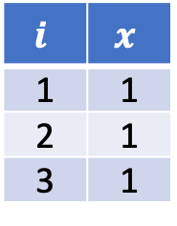
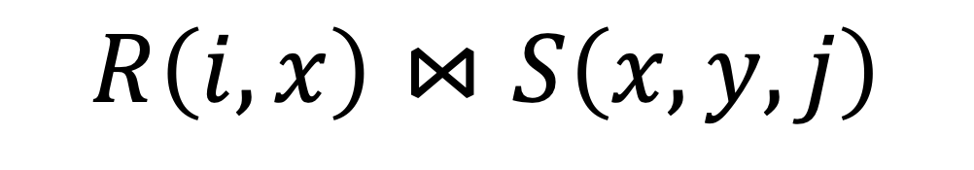

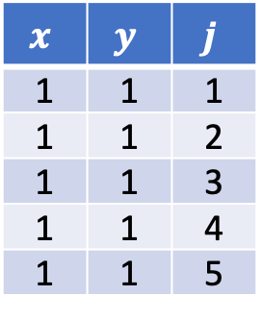

$$R\left(i,x\right)⋈S\left(x,y,j\right)$$
$$R$$
$$i$$ | $$x$$
1 | 1
2 | 1
3 | 1
$$S$$
$$x$$ | $$y$$ | $$j$$
1 | 1 | 1
1 | 1 | 2
1 | 1 | 3
1 | 1 | 4
1 | 1 | 5
Notes:
Start to transition into TTJ by first talking about how binary join works
- TTJ modifies slightly on binary joins
Start with binary join of two relations R and S
Assume standard in-memory hash-join
Build hash table based on the hash key x

Slide 5

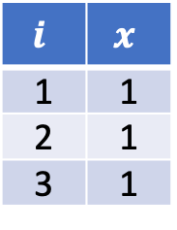
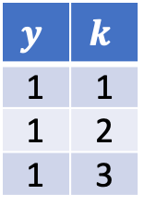

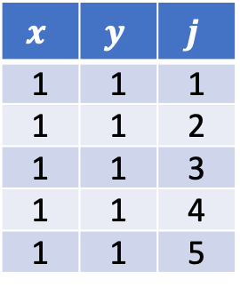


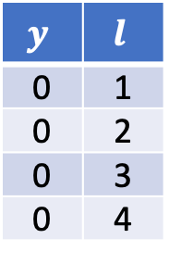
$$Q=R\left(i,x\right)⋈S\left(x,y,j\right)⋈T\left(y,k\right)⋈U(y,l)$$
$$R$$
$$i$$ | $$x$$
1 | 1
2 | 1
3 | 1
$$S$$
$$x$$ | $$y$$ | $$j$$
1 | 1 | 1
1 | 1 | 2
1 | 1 | 3
1 | 1 | 4
1 | 1 | 5
$$T$$
$$y$$ | $$k$$
1 | 1
1 | 2
1 | 3
$$U$$
$$y$$ | $$l$$
0 | 1
0 | 2
0 | 3
0 | 4
Notes:
Extend binary join into multi-way join and pinpoint how binary join wastes effort for this example.
Extend binary join of two relations into binary join of four relations
First build hash tables on S,T, and U based on their join keys S(x), T(y), U(y)
How binary join wastes effort
S(1,1,1) introduces y=1

Slide 6
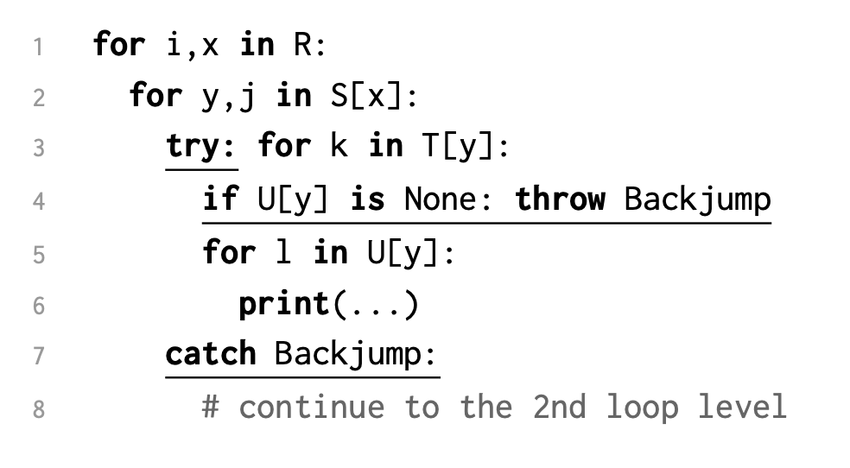
Database Theory
Idea 1: Backjump to the level causing the probe failure
Notes:
Introduce the backjumping idea in TTJ through code snippet
TTJ is designed to handle the situation of binary join
The first idea of TTJ is …
On Line 4,
Exception handled in try … catch at S

Slide 7

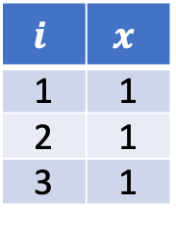
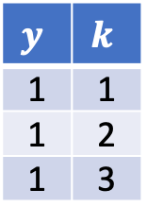

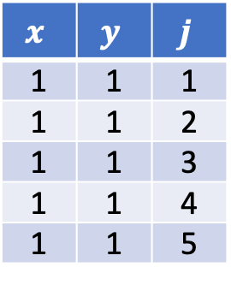



Database Theory
Idea 1: Backjump to the level causing the probe failure
$$R$$
$$i$$ | $$x$$
1 | 1
2 | 1
3 | 1
$$S$$
$$x$$ | $$y$$ | $$j$$
1 | 1 | 1
1 | 1 | 2
1 | 1 | 3
1 | 1 | 4
1 | 1 | 5
$$T$$
$$y$$ | $$k$$
1 | 1
1 | 2
1 | 3
$$U$$
$$y$$ | $$l$$
0 | 1
0 | 2
0 | 3
0 | 4
Notes:
Illustrate the backjumping idea using our running example
Revisit our running example
Evaluation skips T
Red arrow indicates backjumping

Slide 8
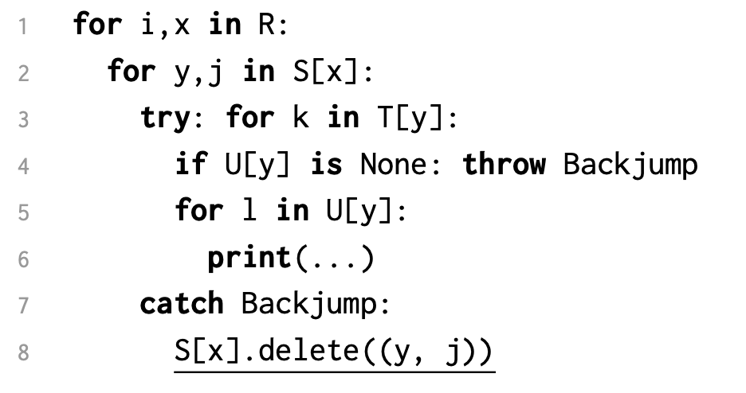
Database Theory
Idea 2: Delete the tuple that causing the probe failure
Notes:
Introduce the tuple deletion idea in TTJ through code snippet
S(1,1,1) is no longer needed
Safe to delete
Line 8

Slide 9
Database Theory
Idea 2 : Delete the tuple that causing the probe failure
$$R$$
$$i$$ | $$x$$
1 | 1
2 | 1
3 | 1
$$S$$
$$x$$ | $$y$$ | $$j$$
1 | 1 | 1
1 | 1 | 2
1 | 1 | 3
1 | 1 | 4
1 | 1 | 5
$$T$$
$$y$$ | $$k$$
1 | 1
1 | 2
1 | 3
$$U$$
$$y$$ | $$l$$
0 | 1
0 | 2
0 | 3
0 | 4
Notes:
Illustrate what just described

Slide 10
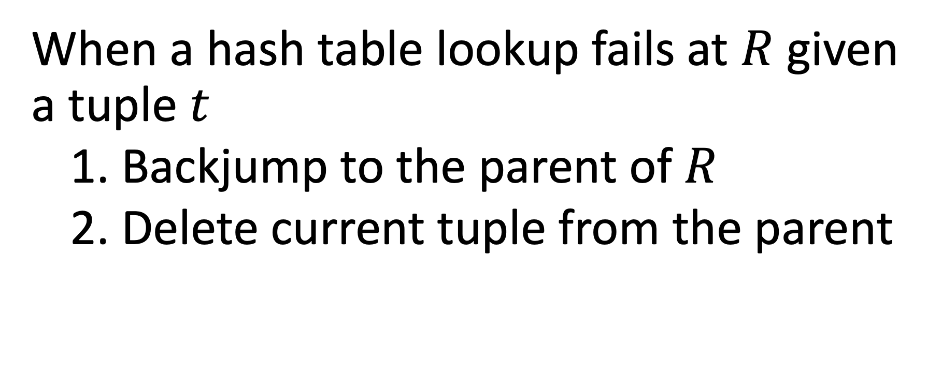
When a hash table lookup fails at $R$ given a tuple $t$
1. Backjump to the parent of $R$
2. Delete current tuple from the parent
Notes:
Summarize the only difference between TTJ and binary join
Happens whenever hash table lookup fails
Backjump happens: execution resets to parent of R
Tuple deletion
Poster:
Upon a lookup failure
1. backjump to the parent
2. delete parent tuple

Slide 11







Database Theory
Keys
Ear
Parent
Reverse of GYO Reduction Order
$$⋈$$
$$⋈$$
$$U(y,l)$$
$$⋈$$
$$T(y,k)$$
$$R(i,x)$$
$$S(x,y,j)$$
Notes:
The key question is how TTJ knows where to backjump to
For a fixed plan, key = join key in the plan
R is an ear if there is another relation 1) ordered before R, and 2) its attributes contain the key of R; another relation = parent
A plan is reverse of GYO reduction order; necessary for linear time guarantee
P1 and p2 are left-deep linear plans (draw a picture of p1 as left-deep linear plan)
Say “ear” is different from the standard definition.
----
Proposition: Keys of the relations are the same for both GYO reduction and reverse of the GYO reduction
Keys: dual purpose: join key for a plan and determines whether the relation is an ear

Slide 12



Database Theory
Keys
Ear
Parent
Reverse of GYO Reduction Order
$$⋈$$
$$⋈$$
$$U(\underline{y},l)$$
$$⋈$$
$$T(\underline{y},k)$$
$$R(i,x)$$
$$S(\underline{x},y,j)$$
Notes:
The key question is how TTJ knows where to backjump to
For a fixed plan, key = join key in the plan
R is an ear if there is another relation 1) ordered before R, and 2) its attributes contain the key of R; another relation = parent
A plan is reverse of GYO reduction order; necessary for linear time guarantee
P1 and p2 are left-deep linear plans (draw a picture of p1 as left-deep linear plan)
Say “ear” is different from the standard definition.
----
Proposition: Keys of the relations are the same for both GYO reduction and reverse of the GYO reduction
Keys: dual purpose: join key for a plan and determines whether the relation is an ear

Slide 13



Database Theory
Keys
Ear
Parent
Reverse of GYO Reduction Order
$$⋈$$
$$⋈$$
$$U(\underline{y},l)$$
Ear
$$⋈$$
$$T(\underline{y},k)$$
Ear
$$R(i,x)$$
$$S(\underline{x},y,j)$$
Ear
Parent
Parent
Notes:
The key question is how TTJ knows where to backjump to
For a fixed plan, key = join key in the plan
R is an ear if there is another relation 1) ordered before R, and 2) its attributes contain the key of R; another relation = parent
A plan is reverse of GYO reduction order; necessary for linear time guarantee
P1 and p2 are left-deep linear plans (draw a picture of p1 as left-deep linear plan)
Say “ear” is different from the standard definition.
----
Proposition: Keys of the relations are the same for both GYO reduction and reverse of the GYO reduction
Keys: dual purpose: join key for a plan and determines whether the relation is an ear

Slide 14
Database Theory
Keys
Ear
Parent
Reverse of GYO Reduction Order
$$⋈$$
$$⋈$$
$$U(\underline{y},l)$$
Ear
$$⋈$$
$$T(\underline{y},k)$$
Ear
$$R(i,x)$$
$$S(\underline{x},y,j)$$
Ear
Notes:
The key question is how TTJ knows where to backjump to
For a fixed plan, key = join key in the plan
R is an ear if there is another relation 1) ordered before R, and 2) its attributes contain the key of R; another relation = parent
A plan is reverse of GYO reduction order; necessary for linear time guarantee
P1 and p2 are left-deep linear plans (draw a picture of p1 as left-deep linear plan)
Say “ear” is different from the standard definition.
----
Proposition: Keys of the relations are the same for both GYO reduction and reverse of the GYO reduction
Keys: dual purpose: join key for a plan and determines whether the relation is an ear

Slide 15







NOT Reverse of GYO Reduction Order
$$⋈$$
$$⋈$$
$$U(\underline{y},l)$$
Ear
$$⋈$$
$$S(\underline{x},\underline{y},j)$$
$$T(y,k)$$
$$R(i,x)$$

Slide 16
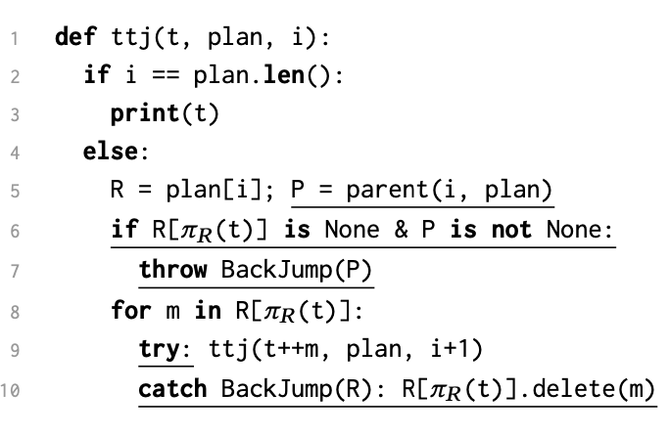

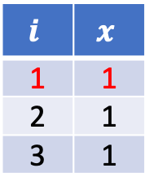


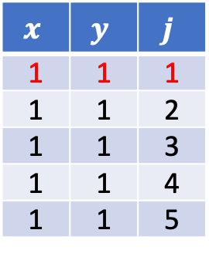



Database Theory
Correctness
Runtime
$$S$$
$$x$$ | $$y$$ | $$j$$
1 | 1 | 1
1 | 1 | 2
1 | 1 | 3
1 | 1 | 4
1 | 1 | 5
$$R$$
$$i$$ | $$x$$
1 | 1
2 | 1
3 | 1
$$T$$
$$y$$ | $$k$$
1 | 1
1 | 2
1 | 3
$$U$$
$$y$$ | $$l$$
0 | 1
0 | 2
0 | 3
0 | 4
Notes:
Correctness
Only difference happens when probe failure
Tuple that fails at U is t (formed by red)
Lookup failure → hash key of t does not appear in U (any tuple has y=1 is not output)
S is parent of U → attributes of S contains key of U
t contains all the attributes of S, then S(1,1,1) contains y=1 can is safe to remove
Can backjump over T because tuple after T also contains S(1,1,1)
Runtime
- Runtime bound to number of TTJ calls due to constant work within each call
Two possible events for each TTJ call: output O(|Q|) or lookup failure and ties to tuple deletion O(|IN|)
Need reverse of GYO reduction order to tie # of TTJ calls due to lookup failure with # of tuple deletion
---------------
Number of TTJ calls = # of Line 3 + # of Line 7 + # of Line 10
Line 10 eventually goes to Line 3 or Line7

Slide 17

TTJ runs in $O(|∑_{i}R_{i}|+\left|Q\right|)$
# lookup (TTJ) $≤$ # lookup (Binary Join)
Notes:
In summary, linear runtime
TTJ has a fewer hash table lookup than binary join
TTJ and HJ has one hash table lookup for each call
TTJ is different from HJ on probe failure
HJ immediately backtracks to the immediately previous relation in the plan whereas TTJ can backjump to an earlier relation
Poster: |IN| not |\sum…|

Slide 18
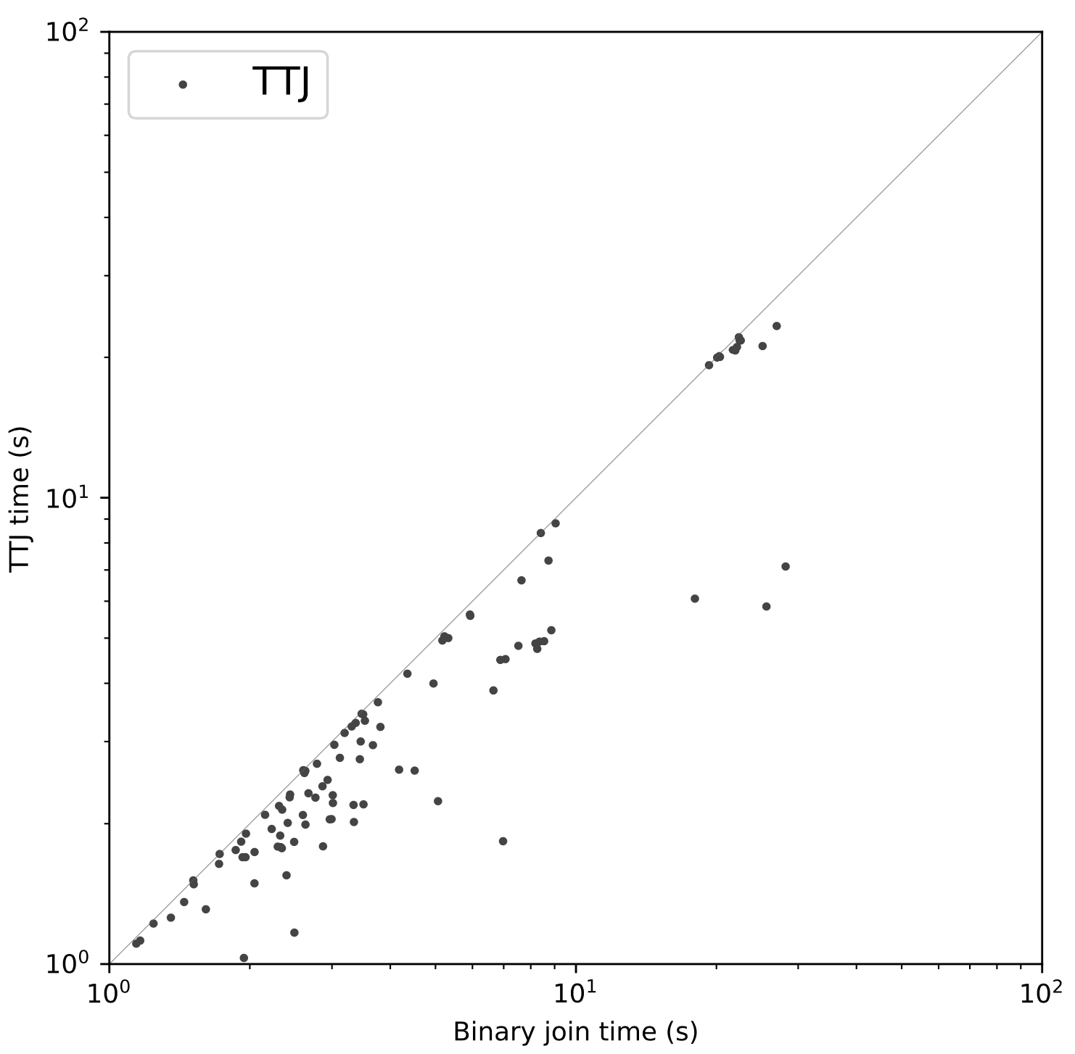
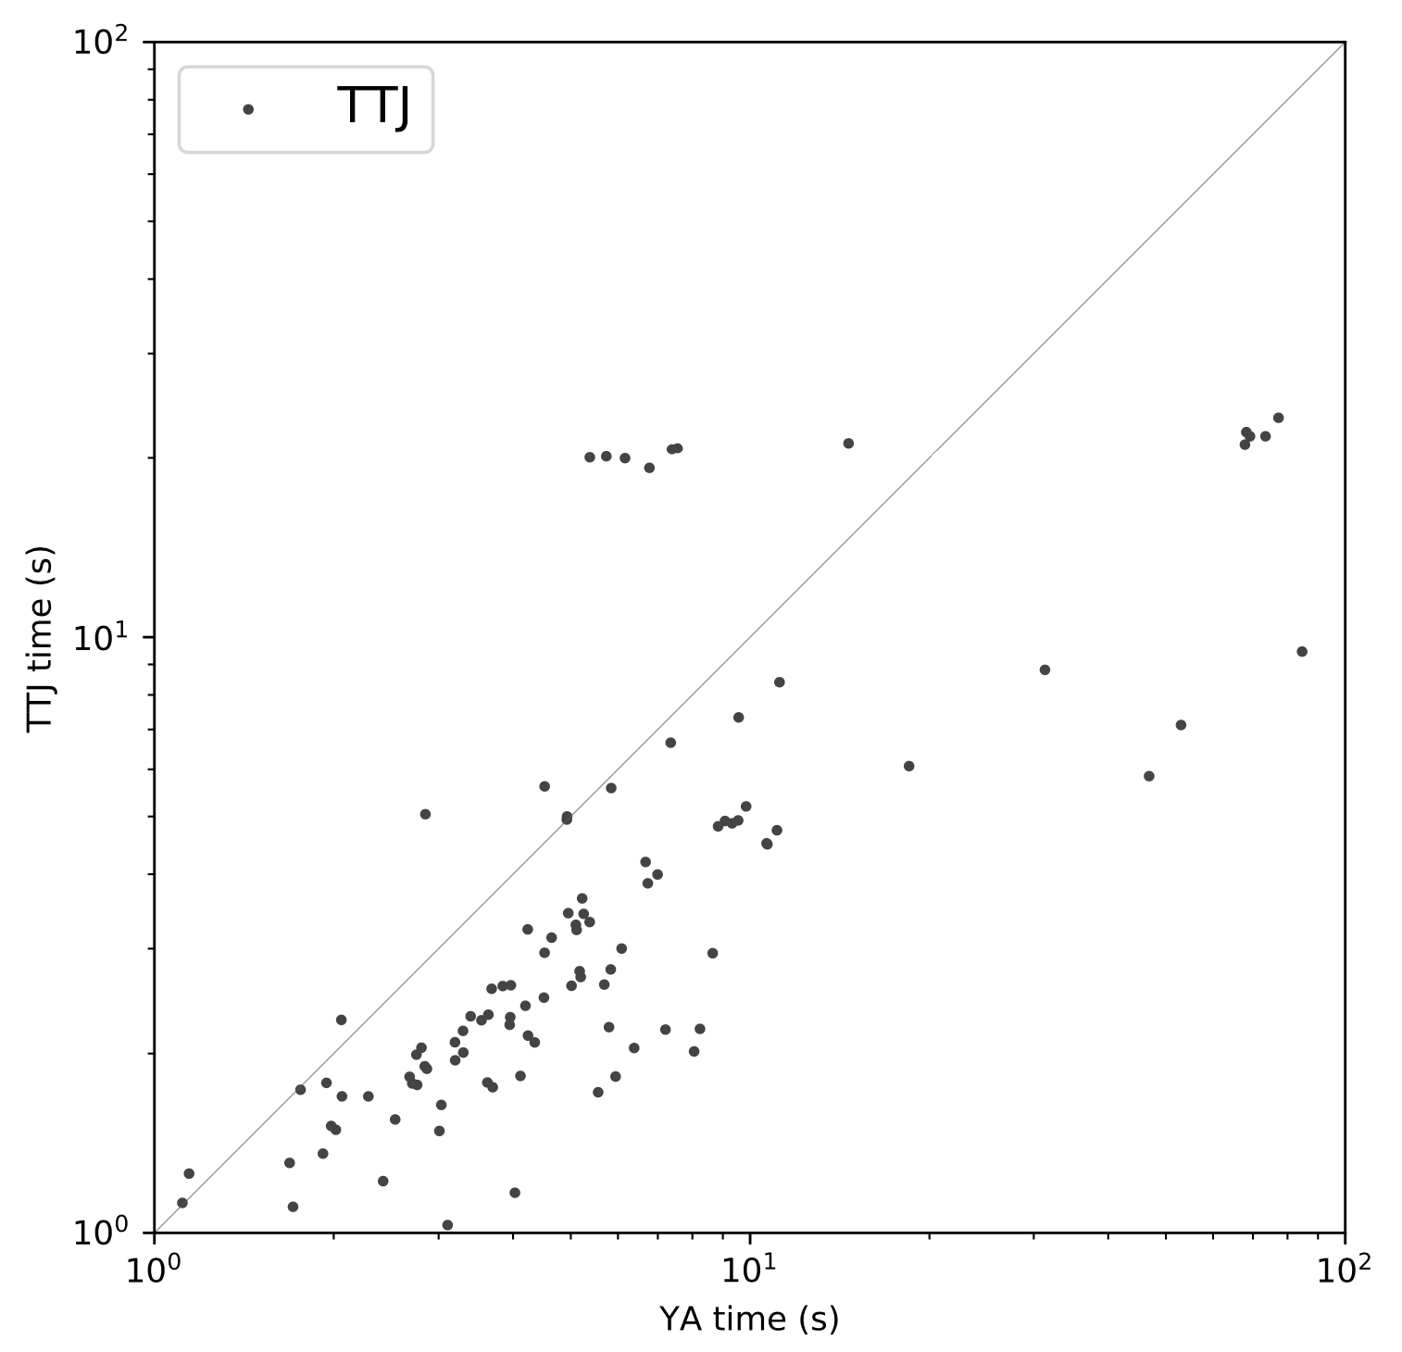
Empirical Results
Notes:
Implementation setup
Implement refinement of YA
Benchmark on JOB
Use SQLite plans for 112/113 of them, one from MySQL due to cross-product
Fastest in 97/113
Figure on the left: difference negligible
Figure on the right: semijoin removes a huge fraction of cast_info before building hash tables

Slide 19
Reflection of TTJ vs. YA
Plans often already encode a join tree
Plan view leads to more powerful notion of ear than query view that works for cyclic queries
Plan view trades-off plan structure for the elimination of semijoin
Notes:
TTJ and YA are two sides of the same coin: some algorithm evaluates ACQ optimally
Difference of these two is their input
The impact of the input difference is
Plan encodes join tree; TTJ works without explicitly constructing a join tree
More powerful notion of ear that works for cyclic
YA provides optimal guarantee while on bushy plan; but, TTJ can remove semijoin. In practice, TTJ has better overall performance
-----
Join tree can support more plan structures with the cost of using semijoin
TTJ can still work with bushy plan but sacrifice optimality guarantee

Slide 20


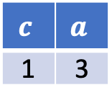
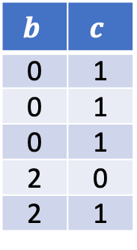

Future work
Provide complexity of using TTJ for cyclic queries based on acyclic convolution + optimization
$$S$$
$$b$$ | $$c$$
0 | 1
0 | 1
0 | 1
2 | 0
2 | 1
$$R$$
$$a$$ | $$b$$
1 | 1
2 | 1
3 | 2
$$T$$
$$c$$ | $$a$$
1 | 3
Notes:
TTJ works for cyclic (* reduce to binary join if it is not an ear)
R and T are not an ear but S is an ear
Use TTJ for R \join S
Same as binary join but make a difference with no-good list
Ear and parent definitions are generalized vs. traditional definitions
Traditional: none of the relations are ears
Traditional starts from the full query and do “minus”; ours starts from nothing and do “addition”
Traditional is “query view” and ours is “plan view”
For example, …
Two views make no difference in acyclic case but do in cyclic case
Aim to generalize the observation on triangle query through a series of graph contraction.
Aim to find a plan such that intermediate results produced by contractions are minimized.

Slide 21
Guiding Idea: CSP = Query Evaluation
TTJ extends TreeTracker from CSP
Yannakakis’s algorithm = an inference algorithm
TreeTracker Join = a search algorithm
Notes:
I want to conclude the talk by remarking that TTJ has a deep root in constraint satisfaction problem
We view plan as an encoding of a CSP and we aim to solve it using search techniques.
TTJ is the query evaluation version of TreeTracker algorithm, which returns one solution over CSP.
Examine YA through the lens of CSP, it is an inference algorithm
Use forward checking to make any pair of relations arc-consistent
Any possible assignment to a relation can be part of the final solution to the CSP.
TTJ as a search algorithm removes the preprocessing step while attaining the optimality
Thank you for your attention. I’m happy to take any questions.
----------------
- TTJ is an extension of a CSP algorithm: TreeTracker
- Yannakakis’s algorithm can be viewed as an inference algorithm
Very similar to AC-4 that invokes forward checking that makes any pair of variables in CSP arc-consistent
- TreeTracker is a search algorithm
Resolves Dechter’s conjecture: whether there existed an optimal algorithm for acyclic CSPs free of any preprocessing

